Slide 1
Life Insurance and retirement valuation

Slide 2
Tutorial 1
Orientation and overview

Slide 3
CONTENT
  Welcome and introduction
  Proposed tutorial content – week 2 and onward
  Exercise
  Assessment standards
  Overview of the LMS & feedback
  Assignment
  Preparation for week 2

Slide 4
Welcome and introduction
- see ‘Welcome’ video in Module 1!

Slide 5
Tutorial content
Your input/feedback is appreciated

Slide 6
Purpose and structure
Purpose:
Prepare for the exam and assignment
Prepare for PD and Apps
Help to develop judgement/critical thinking
Work through how to answer questions
Clarify the textbook
Structure:
Work through questions set a week before
Discuss topics suggested by students
Present on difficult issues
Your ideas?

Slide 7
Topics
Learning objectives in each Module and Module 1
Broadly, two questions in this subject:
    Liability: Future outgo less future income
    Asset value less liability
Answer using:
    Data
    Assumptions
    Method
    Model
Aware of process – i.e. Control Cycle

Slide 8
Cash flows in this subject
Opening balance sheet
Closing balance sheet
A₀
C₀
A₁
C₁
L₀
L₁
How do we estimate L₀ or L₁?
Is C₀ or C₁ ‘large’ enough?
Who owns A₀ or A₁?
Compare actual to expected: A₁ – A_{0 ,} L₁ – L₀ and (A₁ – A₀ ) – (L₁ – L₀)

Slide 9
The future is not known
Balance sheet is not static
  Premiums, or contributions, received
  Asset values change
  Insurance and benefit payouts occur
  Expenses incurred
  Need to revise assumptions
  Rules may change
  Improved models

Slide 10
Topics
Tutorial | Date | Outline (subject to change as we progress through the semester)
1 | 15th Jan | Orientation and course overview
2 | 22nd Jan | Modules 2 & 3 : Framework for valuing cash flows and product cash flows
3 | 29th Jan | Module 4 and 8 (excluding section 8.5): Liabilities and assumptions
4 | 5th Feb | Module 9: Retirement Schemes - also cover assignment questions
 | 12th Feb | No tutorial
5 | 19th Feb | Modules 5 & 6 & 8.5: Life insurance valuation methods
6 | 26th Feb | Modules 7 &10 & 11: Balance sheet, valuation process and assets
 | 4th Mar | No tutorial (assignment due on 2/3/2020)
7 | 11th Mar | Module 12: Analysis of Surplus
8 | 18th Mar | Module 13: Risk Management Frameworks
9 | 25th Mar | Module 14: Capital Management
10 | 1st Apr | Module 15: Appraisal Values

Slide 11
Tutorial Introductory Exercise
An old Foundation (Part 1) question

Slide 12
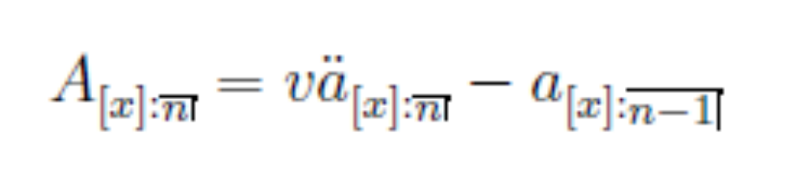
State what you see
Exercise: Demonstrate verbally the equation

Slide 13



Not designed to trick you
Exercise solution
represents a payment of $v at the start of each policy year for a maximum of n years. We are assuming that the symbol v has its usual meaning and thus accumulates to $1 at the end of the policy year if invested at a rate of interest, i.
represents a payment of $1 at the end of each policy year survived to by the life. The number of payments is limited to n-1.
The difference between the two payments represents a net payment of $0 if the life survives the first n-1 years, a payment of $1 if the life dies in first n-1 policy years and a payment of $1 if the life dies or survives the n^{th} policy year. This is the definition of an n-year endowment assurance:

Slide 14
State what you see
Exercise: Discussion
Forgotten the symbols? – see ‘Revision of Life Contingencies’ video in Module 1.
Our role is to describe possibilities in words to clients.
Questions at Fellowship level test:
    Written expression
    Focus on key points
    Explain what you see
    See ‘Transition to Fellowship’ video in Module 2.

Slide 15
Process for answering Fellowship questions
Address the question
State the obvious
Ideas
Structure
Time management
Read question

Slide 16
CMP subject
M06 Modelling
M11 Critical thinking module – helps with structure
Both files pasted in the ‘Week 1’ section under the page ‘Tutorials and other information’

Slide 17
Assessment standards
No fall in Fellowship standards

Slide 18
Assessment
Written assignment weighted by 20%
    See ‘Assignment Question Sem 1 2020’ section in ‘Assignments’ section on LMS
    Marked using ‘rubric’ system
    Rubric provides a guide
    Grades not marks.
    Note Grade B (pass) will be a mixture of the rubric pass and above pass. Grade A is significantly above pass.
Three hour open-book exam weighted by 80%
    Grades not marks

Slide 19
Quality control
Need to reach standard to become a Fellow
New structure is not a fall in standards
Is this subject easier to pass?
    Direct answer – No!
    Indirect answer
      option to be better prepared but that depends on you!
      self-contained textbook
      2 principle-based modules help you with Apps level
Practice committees (Life Insurance & Wealth Management, Superannuation) approve content
Education Council Committee approve standards
Independent examiner provides a check
Head of Education Development assists with consistency across subjects

Slide 20
Overview of the LMS
Report issues/difficulties

Slide 21
Assignment
A brief look

Slide 22
Assignment
Preamble sets out skills developed
    Writing skills
    Neat and tidy
    Stating the obvious
    Applying knowledge
    Using spreadsheets
Note deadline and what happens if you miss the date!
LO: ‘Describe pace of funding and u/s impact on actual experience’

Slide 23
Assignment
Business context
    Unfamiliar situation
    Apply knowledge
    State what you see
    State what you cannot see
    Provided with data - and so what?
    Brief description of products – need to understand implications

Slide 24
Assignment
Data/Assumptions/method/model
    Same for all questions?
    Who is viewing the results?
    Do they think the same way?
    Tailor to your audience
    Neat and tidy
    I need to understand what you are saying - I cannot see inside your head.

Slide 25
Preparation for Tutorial 2
Up to you – active not passive

Slide 26
Tutorial 2
Read Modules 1, 2 and 3 and answer any questions in the textbook
Rewrite Module summaries in your own words
Watch the videos in Module 1, 2 and 3
Practice your writing skills by summarizing the videos in Modules 2 and 3
Write a short note on the reflection exercise on page 13 of Module 2
Use the discussion forum pages for questions/ requests for tutorial topics
Search for real examples for some of the products in Module 3
Answer questions posted under Week 1.

